Slide 1
An update on the transcriptome assembly project
Kris Alavattam
Tsukiyama Lab
2/22/2023

Slide 2
This work necessitates the creation of a new transcriptome assembly built from the 4tU-seq data—but why? And what will we do with it?
Using quiescent yeast cells, we seek to perform a comprehensive characterization of cryptic transcription¹
An important, conserved feature of eukaryotic genomes is pervasive transcription
In S. cerevisiae, at least 85% of the genome is transcribed in cycling cells, resulting in substantial amounts of noncoding transcription
Near or overlapping annotated genes
On the antisense strand
Much of this noncoding transcription degrades on a shorter time scale than transcription detected by, e.g., RNA-seq—as such, it is termed cryptic transcription
Subsets of cryptic transcripts have been characterized and annotated through the knockout of RNA surveillance factors and chromatin modifiers^{2–7}
However, it is an ongoing mystery as to the functions of cryptic transcripts
Alison and the Tsukiyama Lab have shown that quiescent cells are enriched for noncoding transcription in general and antisense transcripts in particular
Thus, using quiescent S. cerevisiae as a model, Alison sought to perform a comprehensive characterization of cryptic transcripts
Alison performed 4tU-seq—also known as "nascent RNA-seq"
4tU-seq is a variant of RNA-seq that enriches for nascent transcription
4tU-seq detects low abundance and labile transcripts that are not detected with standard transcription readouts (unless analyzing cells defective for RNA degradation)
The goal: Identifying and characterizing noncoding and antisense transcripts detected at the entry to quiescence
This will be followed by experiments that infer and define the function of cryptic transcripts
Greenlaw et al., in progress
van Dijk et al., 2011
Wyers et al., 2005
Lykke-Andersen & Jensen, 2011
Schulz et al., 2013
Xu et al., 2009
Vankatesh et al., 2016
Notes:
XUTs (Xrn1 unstable transcripts): 33
van Dijk, E. L. et al. XUTs are a class of Xrn1-sensitive antisense regulatory non-coding RNA in yeast. Nature 475, 114–117 (2011)
CUTs (Cryptic Unstable Transcripts, Rrp6 and/or Trf4): 20, 34, 35
Wyers, F. et al. Cryptic pol II transcripts are degraded by a nuclear quality control pathway involving a new poly(A) polymerase. Cell 121, 725–737 (2005)
Davis, C. A. & Ares, M. Accumulation of unstable promoter-associated transcripts upon loss of the nuclear exosome subunit Rrp6p in Saccharomycescerevisiae. Proc. Natl. Acad. Sci. 103, 3262–3267 (2006)
Lykke-Andersen, S. & Jensen, T. H. CUT it out: silencing of noise in the transcriptome. Nat. Struct. Mol. Biol. 13, 860–861 (2006)
NUTs (Nrd1 Unterminated Transcripts): 36
Schulz, D. et al. Transcriptome Surveillance by Selective Termination of Noncoding RNA Synthesis. Cell 155, 1075–1087 (2013)
SUTs (Stable Unannotated Transcripts): 37
Xu, Z. et al. Bidirectional promoters generate pervasive transcription in yeast. Nature 457, 1033–1037 (2009)
SRATs (Set2 repressed antisense transcripts): 38
Venkatesh, S., Li, H., Gogol, M. M. & Workman, J. L. Selective suppression of antisense transcription by Set2-mediated H3K36 methylation. Nat. Commun. 7, 13610 (2016)

Slide 3
The 4tU-seq-derived assembly makes it possible to characterize cryptic transcription— but what does custom transcriptome assembly entail?
Why do we need a new transcriptome assembly, and what will we do with it?¹
An official, standard S. cerevisiae transcriptome assembly exists—but it doesn’t meet our needs
In Alison’s preliminary work examining nascent transcription at the entry to quiescence, she assembled ~5,500 transcripts— ~30% of which had no same-strand overlap with defined annotations
Thus, official (and other) annotations lack information for quiescence-entry transcription, including…
Noncoding transcription—e.g., antisense and intergenic transcripts
Alternative stop and start sites for transcripts
Upstream transcription—i.e., transcripts that start and stop within promotors
Using the nascent (4tU-seq-derived) transcriptome assembly, we seek to...
Determine the numbers of antisense (AS) transcripts in quiescence-entry (Q) versus G1-arrested (G1) cells, and examine the differences in AS transcription between the two states
Determine the numbers of intergenic transcripts in Q versus G1 cells, again examining the between-state differences
Determine the extent of altered transcription start or stop sites in Q cells
Find, tally, and characterize transcripts that have never been annotated
Having recorded coordinates for altered and/or novel transcripts, we will use the new assembly to...
Measure differential expression in Q versus G1 cells
Classify different kinds of noncoding transcription, inferring relationships between coding and noncoding transcription
Evaluate chromatin structure at classifications/kinds of loci
More...
Greenlaw et al., in progress
Notes:
Associated with bullet #1, sub-bullet #1
Of the assembled transcripts that Alison put together, ~30% had no same-strand overlap with previous annotations—but what about the overlap with defined annotations: Did she recapitulate those annotations? Were there any differences?
Associated with bullet #2, sub-bullet #1
Are there changes in levels of transcription?
Are there positional changes such as changes in start or stop sites?
And, generally, “analysis [to estimate likely functions for given antisense transcript]—for example, are longer [antisense] transcripts [“more”] functional? [Antisense transcripts in] [c]ertain orientations [with respect to] genes? Does the relationship with the promotor matter? (This is very downstream. Your call how much detail you want to talk about it.)

Slide 4
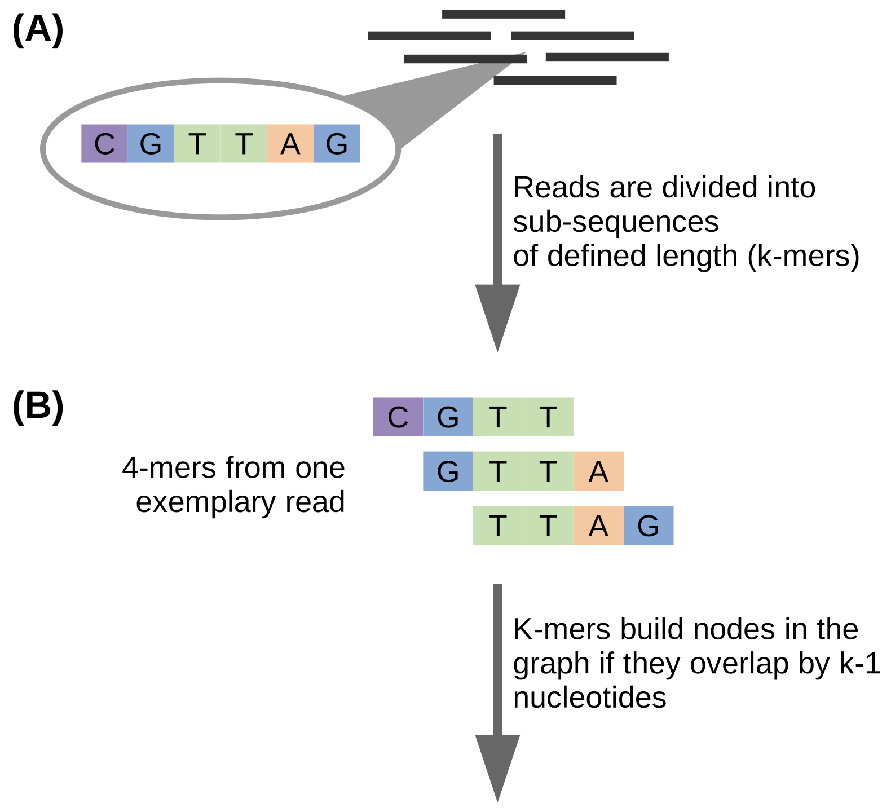
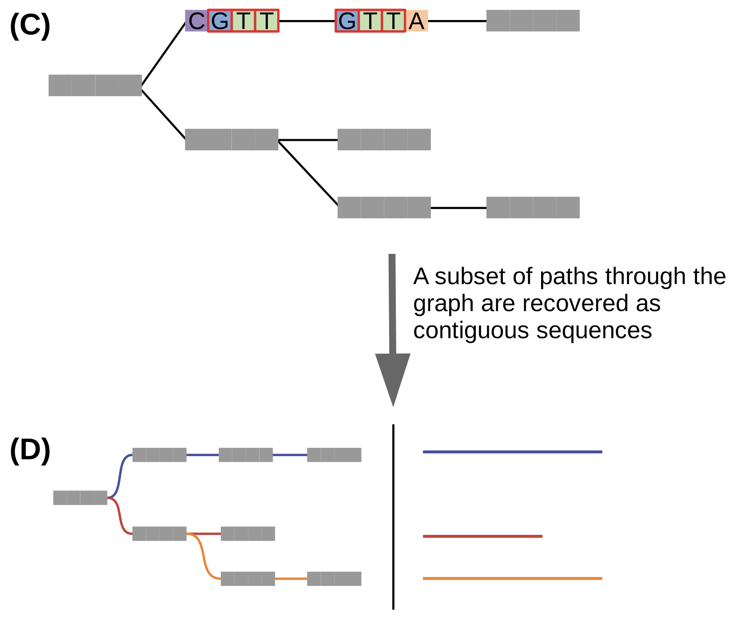
What is it to make a custom transcriptome assembly?
In transcriptome assembly, millions of reads are pieced together to accurately represent their genomic sequences of origin
Assembly is achieved by examining overlaps between reads (or subsequences thereof) in order to concatenate them into longer contiguous sequences (a.k.a., contigs)^{1,2}
Instead of whole reads, most assembly algorithms use k-mers—read-derived substrings of length k³—as assembly units
General steps of the assembly process:
Construct a dictionary of all possible k-mers and their reads of origin (A, B)
Represent the k-mers as nodes (a.k.a., vertices or “points”) in a graph (C)
Form lines between points if they have an overlap of exactly k – 1 nucleotides (C)
Extend paths until no further overlap-based extensions are possible³ (C)
Traverse and record each possible path through the graph: These are contigs; they represent possible origin sequences for the k-mers (D)
Martin & Wang, 2011
Bushmanova et al., 2019
Grabherr et al., 2011
Figure: Raghavan et al., 2022
Notes:
Raghavan et al.: Section “De novo transcriptome assembly”
¶2
Assembly algorithms are mostly based on using k-mers as assembly units instead of whole reads.
A k-mer is a sub-string of length k derived from a particular read [46].
The first step in the assembly process is to construct a dictionary of all possible k-mers (for a given k) and the reads these k-mers originate from.
Most modern assemblers are graph-based in that they represent the k-mers as nodes in a so-called De Bruijn graph (Figure 3).
Subsequently a contig is a path through the graph, where each distinct k-mer represents a vertex in the graph.
Edges are formed between two k-mer vertices if they have an overlap of exactly k-1 nucleotides.
In this way paths through the graph correspond to possible sequences the k-mers originated from (Figure 3).
Paths are extended until no further overlap-based extensions are possible [46].
Then each possible path through the graph is traversed and recovered as a separate contig corresponding to a single transcript.
¶3
…
Subsequently, post-processing steps may be implemented to filter and group contigs to yield a representative set of the assembled sequences.
De Bruijn graph-based assembly is sensitive to the choice of k-mer length as it dictates the set of contigs assembled by controlling the complexity of the graphs.
Citations
15. Martin JA, Wang Z. Next-generation transcriptome assembly. Nat Rev Genet September 2011;12(10):671–82.
56. Bushmanova E, Antipov D, Lapidus A, et al. rnaSPAdes: a de novo transcriptome assembler and its application to RNA-Seq data. Gigascience September 2019;8(9).
46. Grabherr MG, Haas BJ, Yassour M, et al. Full-length transcriptome assembly from RNA-Seq data without a reference genome. Nat Biotechnol May 2011;29(7):644–52.

Slide 5
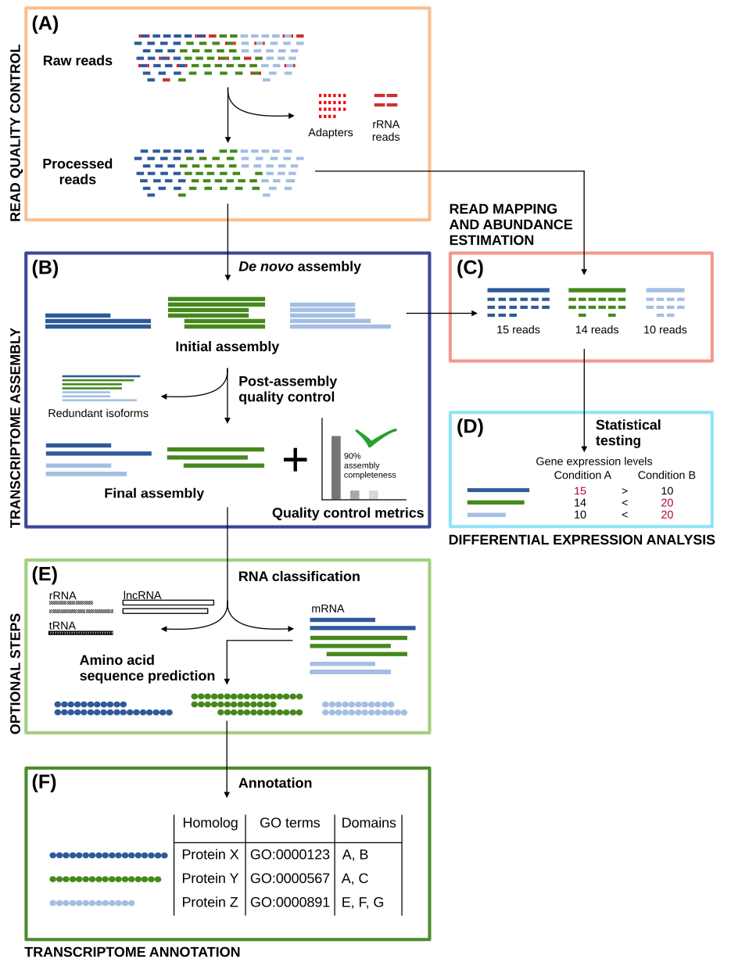
What is it to make a custom transcriptome assembly? We pursue a hybrid strategy
In general, reads can be assembled through one of two approaches:
Reference genome-guided: Assembly occurs through the alignment of reads to the reference genome
Reference genome-free—i.e., de novo: Assembly occurs using only the information contained in the reads
We leverage a hybrid strategy, assembling transcriptomes from the results of both approaches
...but before diving into that, it's important to discuss the general workflow for transcriptome assembly—particularly steps A and B
Figure: Raghavan et al., 2022
Notes:
Rhind-et-al.: Materials and Methods: Transcript reconstruction from RNA-Seq and incorporation into gene annotations (p. 20)
¶1
Transcript reconstruction from RNA-Seq reads was performed using a hybrid approach leveraging genome alignments coupled with de novo RNA-Seq read assembly. RNA-Seq reads were first aligned to genome sequences using TopHat (73) requiring a minimum intron length of 25 bases and a maximum intron length of 1 kb. Unmapped reads were identified and realigned to the genome using the more sensitive BLAT (74) alignment tool. Based on genome alignment coordinates and strand-specificity, reads were partitioned into disjoint strand-specific ‘coverage regions’, and neighboring coverage regions within 1 kb were merged into larger regions. The reads corresponding to alignments in the merged coverage regions were subjected to de novo assembly as part of the transcript reconstruction process described below.
¶2
Prior to de novo assembly, operations were performed to mitigate the errant fusion of adjacent and minimally overlapping transcripts by considering the evidence for transcription contiguity based on read pairing support. A pair contiguity sensor was devised as follows: A 200 base window was slid across each covered region with a step size of 33 bases. The RNA-Seq fragments (defined by either read of pairs derived from single fragments) overlapping the first 50 bases (segment A) and the last 50 bases (segment B) of the 200 base window were identified as fragment sets (A, B). The contiguity of fragment coverage was computed as a Jaccard similarity coefficient: (AB)/(AB). Similarity coefficient values at or below 0.05 trigger a search for a covered region clip point. First, the smallest coefficient value within 100 bases is defined as a candidate clip point. If regions of greater transcript read pair contiguity exist within 300 bases of both sides of the candidate clip point, the covered region is clipped at the candidate site, partitioning the reads into disjoint read sets and ultimately precluding the co-assembly of reads that are divided by the dissection. Read sequences corresponding to alignments within the resulting disjoint coverage regions were de novo assembled using the Inchworm RNA-Seq assembly tool (http://inchworm.sourceforge.net/), using a k-mer length of 25 and requiring a minimum contig length of 100 bases.
¶3
We enhanced the PASA annotation pipeline (75) to leverage RNA-Seq for transcript reconstruction and genome annotation by leveraging strand-specific Inchworm RNA-Seq assemblies similarly to expressed sequence tags (ESTs) as follows. Inchworm-assembled transcript sequences were aligned to the genome using GMAP (76), reporting only the single best-scoring alignment for each transcript.
¶4
Valid transcript alignments were required to align to the genome across at least 90% of their length and with at least 95% sequence identity. Spliced transcript alignments were required to include consensus (GT-AG, GC-AG, AT-AC) dinucleotide splice pairs at intron boundaries. The read-derived k-mer coverage of each inchworm-assembled transcript (a proxy for transcript expression) exists as an attribute of each sequence, incorporated into the accession of the fasta-formatted Inchworm-assembled transcript. The PASA pipeline piles the inchworm transcripts along each strand of the genome with pile height prioritized by the k-mer coverage value, adding transcripts with greater coverage (expression) to piles first. Tentative RNA-Seq assembly artifacts, corresponding to transcripts with >= 30% overlap (by shortest length) of a dominant (prioritized) transcript and at most 10% the k-mer coverage of the dominant transcript were discarded. Remaining valid Inchworm-generated transcript alignments were treated identically to EST alignments in the PASA pipeline and integrated into gene annotations as previously described (75).

Slide 6
What is it to make a custom transcriptome assembly?
(A) The sequencing data is quality controlled
(B) Then, the data is assembled to obtain the reference transcriptome; afterwards, it’s subject to more quality control to produce an artifact-free assembly
(C, D) For further quality control, read alignment and transcript abundance estimation (C) are performed, and differential transcript expression levels can be estimated (D)
(E) If the RNA-seq data are suspected to contain non-mRNA species, RNA classification can be carried out to classify and filter the data
(E) Transcriptomic sequences can also be translated into their amino acid counterparts
(F) The nucleotide (and/or translated protein) sequences can be annotated to assign identifiers and elucidate biological roles
Today, I am focusing on steps (A) and (B)
Figure: Raghavan et al., 2022

Slide 7
What is it to make a custom transcriptome assembly? Preprocessing, assembly, and polishing
For read quality control, we use atria¹ to...
perform adapter removal
trim low-quality read ends
filter out very short reads
We use Rcorrector² to fix random errors generated in sequencing
For transcriptome assembly, run the assembly program Trinity³ twice: once in its genome-free mode and once in its genome-guided mode
We use the output of Trinity as input to PASA⁴ (Program to Assemble Spliced Alignments), which...
aligns the newly assembled transcripts to the genome
filters invalid alignments and transcripts likely to be artifacts of the RNA-Seq assembly process
and reconstructs more complete transcripts using its alignment assembly algorithms
Chuan et al., 2021
Song and Florea, 2015
Grabherr et al., 2011
Haas et al., 2003
Figure: Raghavan et al., 2022
Notes:
#TODO Citations for atria and Rcorrector
On Trinity genome-guided mode
If a genome sequence is available, Trinity offers a method whereby reads are first aligned to the genome, partitioned according to locus, followed by de novo transcriptome assembly at each locus. In this use-case, the genome is only being used as a substrate for grouping overlapping reads into clusters that will then be separately fed into Trinity for de novo transcriptome assembly. This is very much unlike typical genome-guided approaches (e.g., Cufflinks) where aligned reads are stitched into transcript structures and where transcript sequences are reconstructed based on the reference genome sequence. Here, transcripts are reconstructed based on the actual read sequences.
Rhind et al.: Materials and Methods: Transcript reconstruction from RNA-Seq and incorporation into gene annotations (p. 20)
¶1
Transcript reconstruction from RNA-Seq reads was performed using a hybrid approach leveraging genome alignments coupled with de novo RNA-Seq read assembly. RNA-Seq reads were first aligned to genome sequences using TopHat (73) requiring a minimum intron length of 25 bases and a maximum intron length of 1 kb. Unmapped reads were identified and realigned to the genome using the more sensitive BLAT (74) alignment tool. Based on genome alignment coordinates and strand-specificity, reads were partitioned into disjoint strand-specific ‘coverage regions’, and neighboring coverage regions within 1 kb were merged into larger regions. The reads corresponding to alignments in the merged coverage regions were subjected to de novo assembly as part of the transcript reconstruction process described below.
¶2
Prior to de novo assembly, operations were performed to mitigate the errant fusion of adjacent and minimally overlapping transcripts by considering the evidence for transcription contiguity based on read pairing support. A pair contiguity sensor was devised as follows: A 200 base window was slid across each covered region with a step size of 33 bases. The RNA-Seq fragments (defined by either read of pairs derived from single fragments) overlapping the first 50 bases (segment A) and the last 50 bases (segment B) of the 200 base window were identified as fragment sets (A, B). The contiguity of fragment coverage was computed as a Jaccard similarity coefficient: (AB)/(AB). Similarity coefficient values at or below 0.05 trigger a search for a covered region clip point. First, the smallest coefficient value within 100 bases is defined as a candidate clip point. If regions of greater transcript read pair contiguity exist within 300 bases of both sides of the candidate clip point, the covered region is clipped at the candidate site, partitioning the reads into disjoint read sets and ultimately precluding the co-assembly of reads that are divided by the dissection. Read sequences corresponding to alignments within the resulting disjoint coverage regions were de novo assembled using the Inchworm RNA-Seq assembly tool (http://inchworm.sourceforge.net/), using a k-mer length of 25 and requiring a minimum contig length of 100 bases.
¶3
We enhanced the PASA annotation pipeline (75) to leverage RNA-Seq for transcript reconstruction and genome annotation by leveraging strand-specific Inchworm RNA-Seq assemblies similarly to expressed sequence tags (ESTs) as follows. Inchworm-assembled transcript sequences were aligned to the genome using GMAP (76), reporting only the single best-scoring alignment for each transcript.
¶4
Valid transcript alignments were required to align to the genome across at least 90% of their length and with at least 95% sequence identity. Spliced transcript alignments were required to include consensus (GT-AG, GC-AG, AT-AC) dinucleotide splice pairs at intron boundaries. The read-derived k-mer coverage of each inchworm-assembled transcript (a proxy for transcript expression) exists as an attribute of each sequence, incorporated into the accession of the fasta-formatted Inchworm-assembled transcript. The PASA pipeline piles the inchworm transcripts along each strand of the genome with pile height prioritized by the k-mer coverage value, adding transcripts with greater coverage (expression) to piles first. Tentative RNA-Seq assembly artifacts, corresponding to transcripts with >= 30% overlap (by shortest length) of a dominant (prioritized) transcript and at most 10% the k-mer coverage of the dominant transcript were discarded. Remaining valid Inchworm-generated transcript alignments were treated identically to EST alignments in the PASA pipeline and integrated into gene annotations as previously described (75).

Slide 8
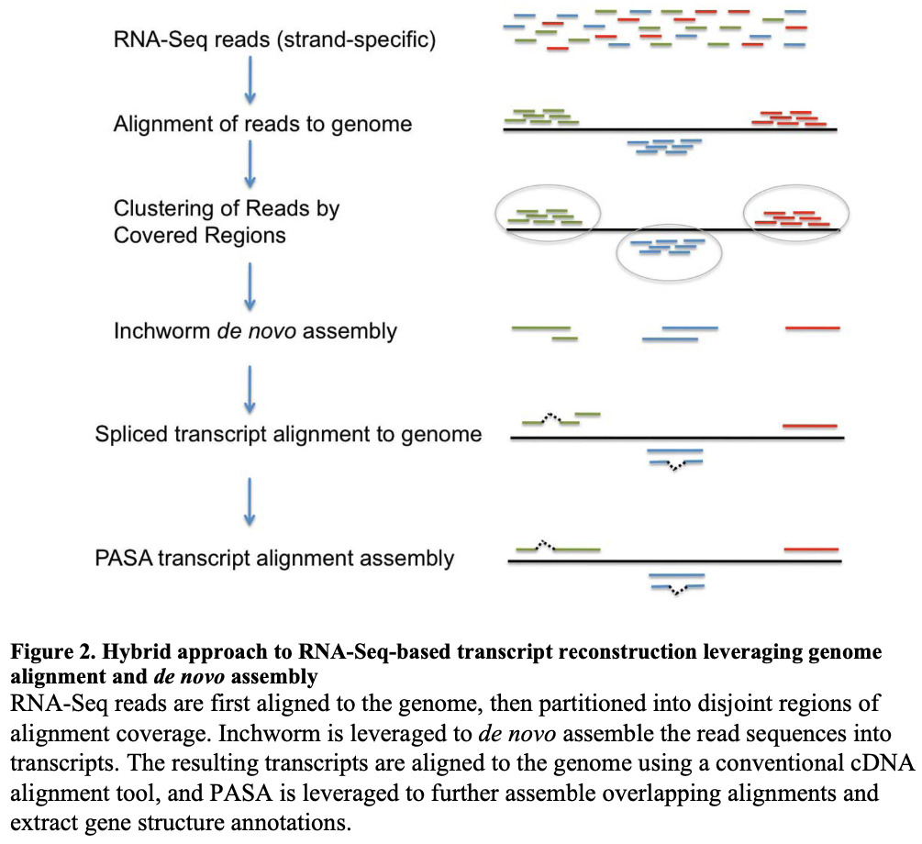
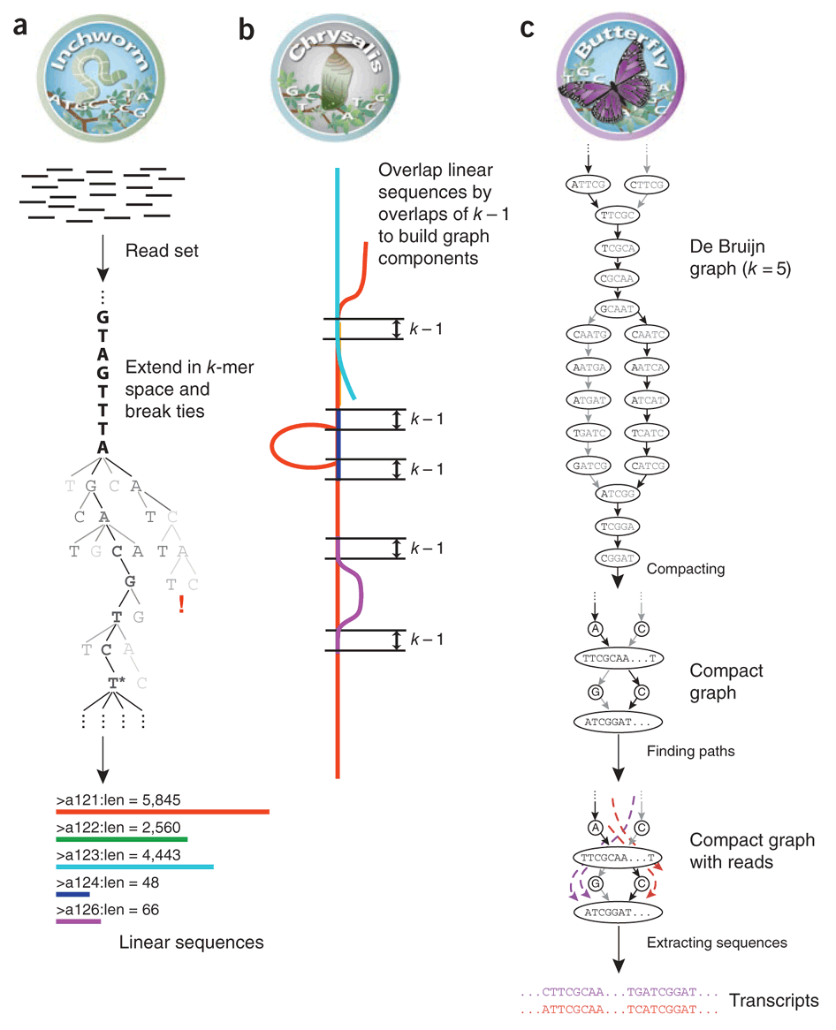
What is it to make a custom transcriptome assembly? An overview of de novo assembly
Trinity GF Trinity GG
Trinity GF Trinity GG
Trinity GF Trinity GG
Trinity GF Trinity GG
a, b, c
Trinity GF Trinity GG
Trinity GF Trinity GG
#TODO figure citations

Slide 9
What is it to make a custom transcriptome assembly? An overview of de novo assembly
Trinity GF Trinity GG
Trinity GF Trinity GG
Trinity GF Trinity GG
Trinity GF Trinity GG
a, b, c
Trinity GF Trinity GG
Trinity GF Trinity GG
GF: “Genome-free” Trinity
GG: “Genome-guided” Trinity
#TODO figure citations

Slide 10
What is it to make a custom transcriptome assembly? An overview of de novo assembly
*Trinity’s assembly process consists of running three programs in succession: Inchworm, Chrysalis, and Butterfly
Inchworm: Construct a dictionary of all possible k-mers and their reads of origin (A, B)
Chrysalis: Represent the k-mers as nodes (a.k.a., vertices or “points”) in a graph (C)
Chrysalis: Form lines between points having an overlap of exactly k – 1 nucleotides (C)
Chrysalis: Extend paths until no further overlap-based extensions are possible (C)
Butterfly: Traverse and record each possible path through the graph, resulting in contigs (D)
GF GG
GF GG
GF GG
GF GG
*followed by Chrysalis, then Butterfly
GMAP
PASA
GF: “Genome-free” Trinity
GG: “Genome-guided” Trinity
#TODO figure citations

Slide 11
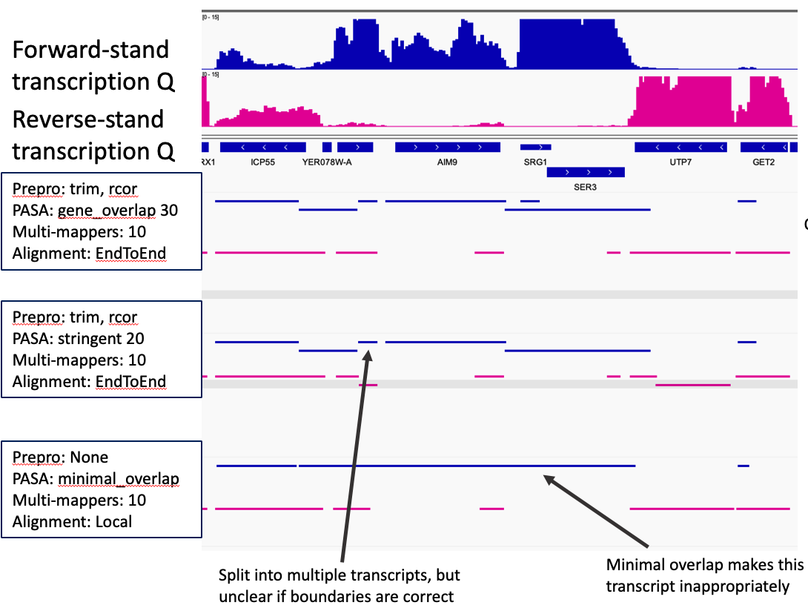
What is it to make a custom transcriptome assembly? Keying into Trinity
Encountered several problems in our initial assemblies, which were built using Trinity’s default parameters
These include incorrect transcript splits, incorrect transcript fusion (apparent over-reconstruction of known isoforms and spurious merging of neighbor isoforms), ectopic transcript fragments, dubious transcript overlaps, and more
Thus, designed and implemented experiments to vary the parameters of Trinity Inchworm and Chrysalis
Figure: Grabherr et al., 2011

Slide 12
We encountered problems using Trinity’s default parameters, so we set about to vary the parameters
We encountered several problems in our initial assemblies, which were built using Trinity’s default parameters*
These include incorrect transcript splits, erroneous transcript fusion (apparent over-reconstruction of known isoforms and spurious merging of neighbor isoforms), ectopic transcript fragments, dubious transcript overlaps, and more
Thus, we designed and implemented experiments to vary the parameters of Trinity Inchworm and Chrysalis (a, b)
*What is a parameter? A quantity in a mathematical model whose value is selected for particular circumstances and in relation to other variable quantities
For example, in y = mx + b, m is a parameter
In y = β₁x² + β₂x + ε, β₁ and β₂ are parameters
Figure: Grabherr et al., 2011

Slide 13
We encountered problems using Trinity’s default parameters, so we set about to vary the parameters
We encountered several problems in our initial assemblies, which were built using Trinity’s default parameters*
These include incorrect transcript splits, erroneous transcript fusion (apparent over-reconstruction of known isoforms and spurious merging of neighbor isoforms), ectopic transcript fragments, dubious transcript overlaps, and more
Thus, we designed and implemented experiments to vary the parameters of Trinity Inchworm and Chrysalis (A–C)
*Trinity’s assembly process consists of running three programs in succession: Inchworm, Chrysalis, and Butterfly
Inchworm: Construct a dictionary of all possible k-mers and their reads of origin (A, B)
Chrysalis: Represent the k-mers as nodes (a.k.a., vertices or “points”) in a graph (C)
Chrysalis: Form lines between points having an overlap of exactly k – 1 nucleotides (C)
Chrysalis: Extend paths until no further overlap-based extensions are possible (C)
Butterfly: Traverse and record each possible path through the graph, resulting in contigs (D)

Slide 14
We encountered problems using Trinity’s default parameters, so we set about to vary the parameters
*
**
We determined four parameters to vary: two for Inchworm and two for Chrysalis
--min_kmer_cov [Inchworm, default: 1]*
minimum k-mer coverage: the minimum count for k-mers to be assembled (i.e., extended)
e.g., --min_kmer_cov 2 means singleton kmers—i.e., kmers supported by only one read—are excluded
--min_iso_ratio [Inchworm, default: 0.05]*
the minimum fraction of average k-mer coverage between two contigs required for gluing them together
takes the k-mer abundance into account when performing Inchworm contig clustering, mainly to prevent very lowly expressed contigs from being clustered together with highly expressed contigs
--min_glue [Chrysalis, default: 2]**
minimum number of reads needed to glue two Inchworm contigs together
--glue_factor [Chrysalis, default: 0.05]**
fraction of maximum Inchworm pair coverage required for gluing
--glue_factor increases the --min_glue value on a Inchworm contig-pair basis such that it de- or increases the support required to glue the pair based on each one’s k-mer coverage
by default, more highly expressed contigs (higher k-mer coverage) must have more evidence (reads) to be glued together
Figure: Grabherr et al., 2011

Slide 15
We encountered problems using Trinity’s default parameters, so we set about to vary the parameters
*
**
--min_kmer_cov [Inchworm, default: 1]*
minimum k-mer coverage: the minimum count for k-mers to be assembled (extended)
values tested: 1, 2, 4, 8, 16, 32 [6 values]
--min_iso_ratio [Inchworm, default: 0.05]*
the minimum fraction of average k-mer coverage between two contigs required for gluing them together
values tested: 0.005, 0.01, 0.05, 0.1 [4 values]
--min_glue [Chrysalis, default: 2]**
minimum number of reads needed to glue two Inchworm contigs together
values tested: 1, 2, 4 [3 values]
--glue_factor [Chrysalis, default: 0.05]**
--glue_factor increases the --min_glue value on a Inchworm contig-pair basis such that it de- or increases the support required to glue the pair based on each one’s k-mer coverage
by default, more highly expressed contigs (higher k-mer coverage) must have more evidence (reads) to be glued together
values tested: 0.005, 0.01, 0.05, 0.1 [4 values]
Permutations: 6 × 4 × 3 × 4 = 288
Once for Trinity GG with quiescent 4tU-seq data: 288 #DONE‡
Once for Trinity GF with quiescent 4tU-seq data: 288 #DONE‡
Once for Trinity GG with G1 4tU-seq data: 288 #DONE‡
Once for Trinity GF with G1 4tU-seq data: 288 #INPROGRESS‡
Assemblies to evaluate: 288 × 4 = 1,152
Figure: Grabherr et al., 2011
‡A small number of jobs (executions of the Trinity submitted to the FHCC compute cluster) failed #TODO Determine why and fix them

Slide 16
We encountered problems using Trinity’s default parameters, so we set about to vary the parameters
Inchworm
*Trinity’s assembly process consists of running three programs in succession: Inchworm, Chrysalis, and Butterfly
Inchworm: Construct a dictionary of all possible k-mers and their reads of origin (A, B)
Chrysalis: Represent the k-mers as nodes (a.k.a., vertices or “points”) in a graph (C)
Chrysalis: Form lines between points having an overlap of exactly k – 1 nucleotides (C)
Chrysalis: Extend paths until no further overlap-based extensions are possible (C)
Butterfly: Traverse and record each possible path through the graph, resulting in contigs (D)
We determined four parameters to vary: two for Inchworm and two for Chrysalis
--min_kmer_cov [Inchworm (A, B), default: 1]
minimum k-mer coverage: the minimum read count for k-mers to be assembled (i.e., extended)
e.g., --min_kmer_cov 2 means singleton kmers—i.e., kmers supported by only one read—are excluded
--min_iso_ratio [Inchworm (A, B), default: 0.05]
the minimum fraction of average k-mer coverage (reads associated with the k-mer) between two contigs required for gluing them together
takes the k-mer abundance into account when performing Inchworm contig clustering, mainly to prevent very lowly expressed contigs from being clustered together with highly expressed contigs
--min_glue [Chrysalis (C), default: 2]
minimum number of reads needed to glue two Inchworm contigs together
--glue_factor [Chrysalis (C), default: 0.05]
fraction of maximum Inchworm pair coverage required for gluing
--glue_factor increases the --min_glue value on an Inchworm contig-pair basis such that it decreases or increases the support required to glue the pair based on each one’s k-mer coverage
by default, highly expressed contigs (higher k-mer coverage) must have more evidence (reads) to be glued together
Inchworm
Chrysalis
Butterfly
Figure: Grabherr et al., 2011

Slide 17
We encountered problems using Trinity’s default parameters, so we set about to vary the parameters
Inchworm
*Trinity’s assembly process consists of running three programs in succession: Inchworm, Chrysalis, and Butterfly
Inchworm: Construct a dictionary of all possible k-mers and their reads of origin (A, B)
Chrysalis: Represent the k-mers as nodes (a.k.a., vertices or “points”) in a graph (C)
Chrysalis: Form lines between points having an overlap of exactly k – 1 nucleotides (C)
Chrysalis: Extend paths until no further overlap-based extensions are possible (C)
Butterfly: Traverse and record each possible path through the graph, resulting in contigs (D)
--min_kmer_cov [Inchworm, default: 1]*
minimum k-mer coverage: the minimum count for k-mers to be assembled (extended)
values tested: 1, 2, 4, 8, 16, 32 [6 values]
--min_iso_ratio [Inchworm, default: 0.05]*
the minimum fraction of average k-mer coverage (reads associated with the k-mer) between two contigs required for gluing them together
values tested: 0.005, 0.01, 0.05, 0.1 [4 values]
--min_glue [Chrysalis, default: 2]**
minimum number of reads needed to glue two Inchworm contigs together
values tested: 1, 2, 4 [3 values]
--glue_factor [Chrysalis, default: 0.05]**
--glue_factor increases the --min_glue value on an Inchworm contig-pair basis such that it decreases or increases the support required to glue the pair based on each one’s k-mer coverage
by default, more highly expressed contigs (higher k-mer coverage) must have more evidence (reads) to be glued together
values tested: 0.005, 0.01, 0.05, 0.1 [4 values]
Permutations: 6 × 4 × 3 × 4 = 288
Once for Trinity GG with quiescent 4tU-seq data: 288 #DONE‡
Once for Trinity GF with quiescent 4tU-seq data: 288 #DONE‡
Once for Trinity GG with G1 4tU-seq data: 288 #DONE‡
Once for Trinity GF with G1 4tU-seq data: 288 #INPROGRESS‡
Assemblies to evaluate: 288 × 4 = 1,152
Inchworm
Chrysalis
Butterfly
Figure: Grabherr et al., 2011
‡A small number of jobs (executions of the Trinity submitted to the
FHCC compute cluster) failed #INPROGRESS Determine why and fix them

Slide 18
Calculate and evaluate metrics that demonstrate the completeness and correctness of the >1,000 assembled transcriptomes: Maximize or minimize the following
Transcript* metrics calculated without alignment to a reference genome and without comparisons to a gene database**
No. transcripts assembled
Transcript length distribution, including percentiles, mean, median, max, etc.
No. transcripts > 500 bp
Transcript N50: A length N such that ≥50% of transcript nucleotides are found in transcripts greater than or equal to this length (i.e., at least half of all assembled bases are in transcripts of at least the N50 length value)
Metrics calculated with alignment information (i.e., alignment to the most recent official S. cerevisiae S288c genome assembly, R64) but without comparisons to a gene database
No. transcripts aligned
No. transcripts uniquely aligned
No. transcripts unaligned
Metrics calculated with alignment information and with comparisons to a gene database
Sensitivity (a.k.a., recall): Measurements of assembly completeness
Database coverage: No. bases covered by all transcripts ÷ length of database isoforms
x% assembled isoforms: No. database isoforms that have at least x% captured by a single transcript (50%, 95%)
Mean isoform assembly: Take the average of (largest no. of isoform_{n} bases captured by a single transcript ÷ length isoform_{n})
Specificity: Measurements of assembly correctness
Unannotated: No. transcripts that are unannotated—i.e., that do not cover any isoform in the gene database
x% matched transcripts: No. transcripts that have at least x% covering a database isoform (50%, 95%)
Mean fraction of transcript matched: Take the average of (no. transcript_{n} bases covering database isoform(s) ÷ length transcript_{n})
*Here, the term “transcript” is a synonym for “post-assembly contig;” thus, a “transcript” is an “assembled putative transcript” that remains to be validated
**Here, the term “gene database” refers to the official gene annotations contained in a gene feature format file (gff file) from, e.g., the Saccharomyces Genome Database (SGD)
Notes:
Trying to capture comments people are making about this slide
Distributions of ORFs...
No. transcripts (less than or greater than?) 2 kb is very small—didn’t catch this
Look at gaps between transcripts units rather than length—can be good for optimizing conditions to avoid fusion transcripts in gene-dense regions
AG’s idea for determining percent gap from subtracting bed from genome (follow up with AG on this—where are we getting the bed from?)
Spot check differences between W303 and s288c (good idea for GG)—but how exactly? Follow up with AG and TT about this

Slide 19
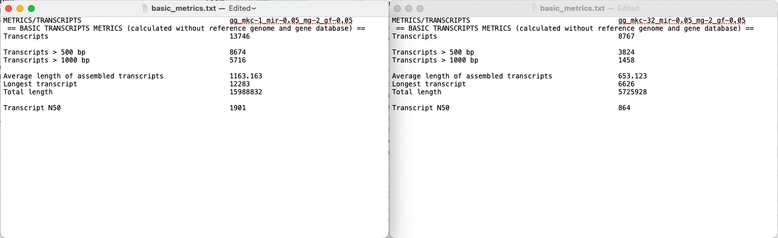
Changing minimum kmer coverage from 1 to 32 results in 36% less assembled transcripts and transcripts that are on average 43% shorter (transcripts > 500 bp: 63% versus 44%)
mkc: --min_kmer_cov [Inchworm (A, B), default: 1]
mir: --min_iso_ratio [Inchworm (A, B), default: 0.05]
mg: --min_glue [Chrysalis (C), default: 2]
gf: --glue_factor [Chrysalis (C), default: 0.05]

Slide 20
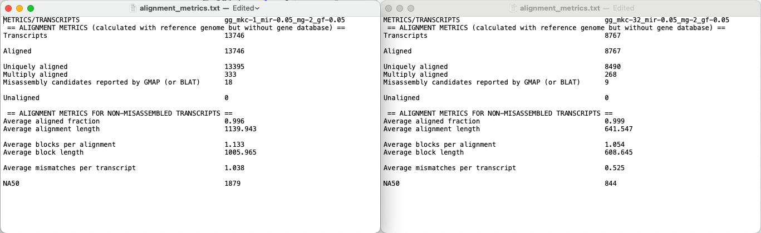
Changing minimum kmer coverage from 1 to 32 results in 36% less assembled transcripts and alignments that are 43% shorter on average
mkc: --min_kmer_cov [Inchworm (A, B), default: 1]
mir: --min_iso_ratio [Inchworm (A, B), default: 0.05]
mg: --min_glue [Chrysalis (C), default: 2]
gf: --glue_factor [Chrysalis (C), default: 0.05]

Slide 21
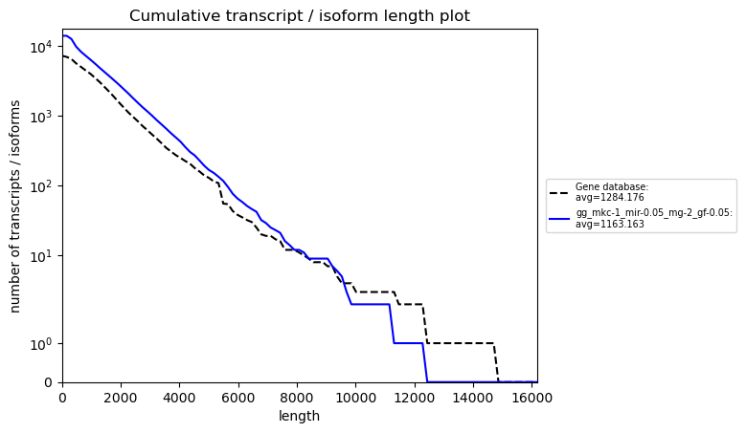
Using default settings, cumulative transcript-length distributions resemble those of cumulative database-isoform-length distributions
mkc: --min_kmer_cov [Inchworm (A, B), default: 1]
mir: --min_iso_ratio [Inchworm (A, B), default: 0.05]
mg: --min_glue [Chrysalis (C), default: 2]
gf: --glue_factor [Chrysalis (C), default: 0.05]

Slide 22
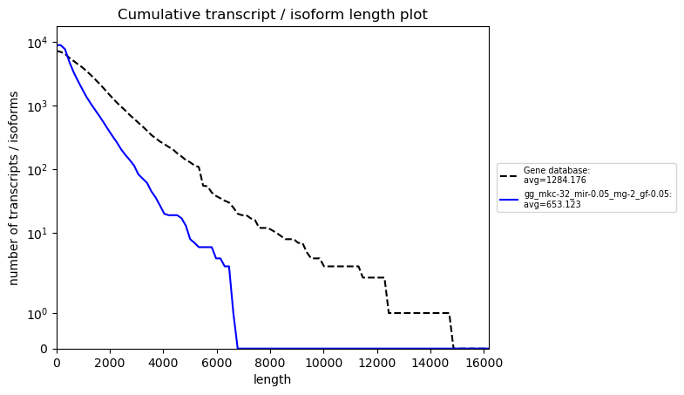
Increasing the kmer coverage from 1 (default) to 32 decreases the length of transcripts versus the length of database isoforms
mkc: --min_kmer_cov [Inchworm (A, B), default: 1]
mir: --min_iso_ratio [Inchworm (A, B), default: 0.05]
mg: --min_glue [Chrysalis (C), default: 2]
gf: --glue_factor [Chrysalis (C), default: 0.05]

Slide 23
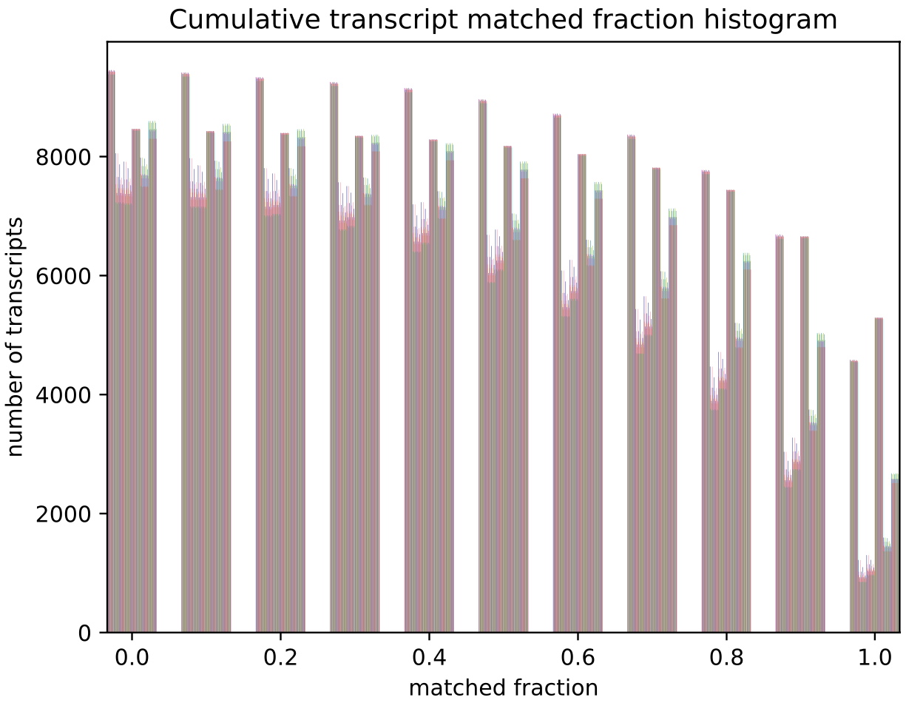
A general trend for minimum kmer coverage and x% matched transcripts
Each bar represents the number of transcripts that have at least x% matched to a database isoform
Notes:
What are the transcripts lost from loss of sensitivity?
Make a decision: prioritize sensitivity and accuracy
The assembly is for the field as much as it is for the lab

Slide 24
Outline for remaining slides
Transition to the calculation of various metrics that demonstrate the completeness and correctness
Show results for some of the apparently more important ones
Communicate ideas about figuring out what we need to maximize and minimize, what I currently think, etc.

Slide 25
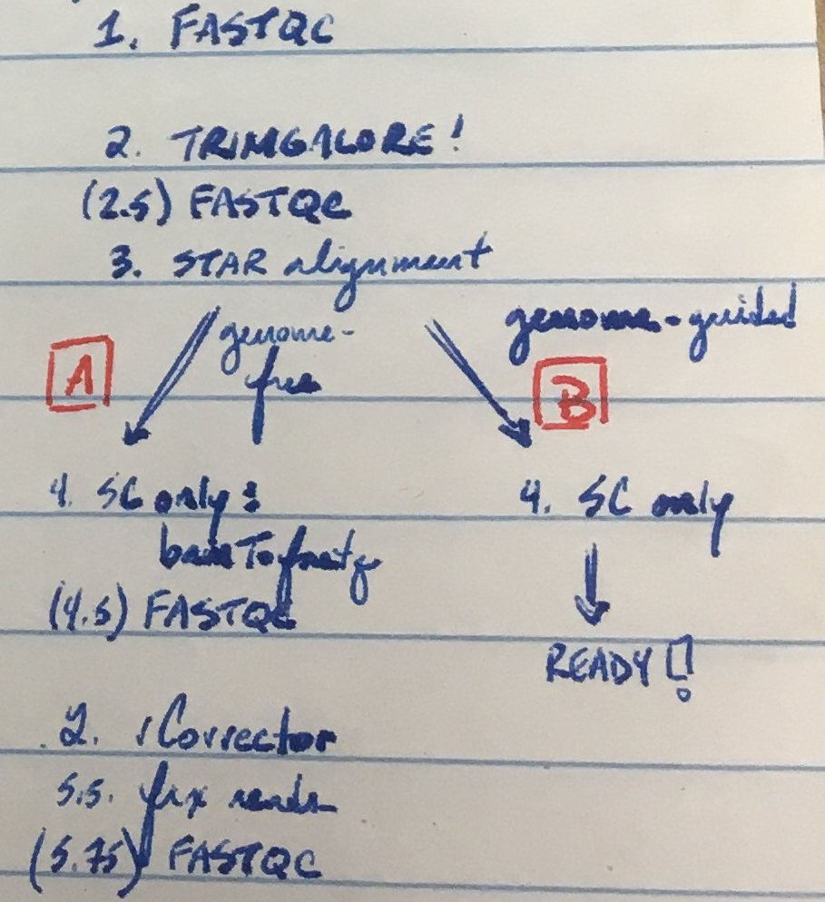
What is it to make a custom transcriptome assembly?
The S. cerevisiae 4tU-seq data contains spike-in sequences from another yeast species, K. lactis
Data are aligned to a combined reference genome composed of S. cerevisiae, K. lactis, and the 20S RNA narnavirus
Alignments to K. lactis and 20S sequences are removed
Handwritten notes for sussing out the preprocessing and alignment steps

Slide 26
In an experiment to optimize read quality control and transcriptome assembly settings, we generated hundreds of transcriptome assemblies…
(A) We input reads that were…
Not processed
Processed with trim_galore alone
Processed with Rcorrector alone
Processed with both trim_galore and Rcorrector
(A–B) We aligned (STAR) reads in two different modes:
EndToEnd
Local
(B) Run Trinity genome-guided mode allowing n numbers of multi-mapping reads:
1 (i.e., multi-mapping reads not allowed)
5
10
15
50
100
Run Trinity genome-free mode not allowing multi-mapping reads
Input the results of Trinity genome-guided and genome-free runs to PASA, running it with its three different algorithms to cluster and assemble alignments
minimal_overlap
stringent_alignment_overlap
gene_overlap
Figure: Raghavan et al., 2022
Notes:
On Trinity genome-guided mode
If a genome sequence is available, Trinity offers a method whereby reads are first aligned to the genome, partitioned according to locus, followed by de novo transcriptome assembly at each locus. In this use-case, the genome is only being used as a substrate for grouping overlapping reads into clusters that will then be separately fed into Trinity for de novo transcriptome assembly. This is very much unlike typical genome-guided approaches (e.g., Cufflinks) where aligned reads are stitched into transcript structures and where transcript sequences are reconstructed based on the reference genome sequence. Here, transcripts are reconstructed based on the actual read sequences.
Rhind et al.: Materials and Methods: Transcript reconstruction from RNA-Seq and incorporation into gene annotations (p. 20)
¶1
Transcript reconstruction from RNA-Seq reads was performed using a hybrid approach leveraging genome alignments coupled with de novo RNA-Seq read assembly. RNA-Seq reads were first aligned to genome sequences using TopHat (73) requiring a minimum intron length of 25 bases and a maximum intron length of 1 kb. Unmapped reads were identified and realigned to the genome using the more sensitive BLAT (74) alignment tool. Based on genome alignment coordinates and strand-specificity, reads were partitioned into disjoint strand-specific ‘coverage regions’, and neighboring coverage regions within 1 kb were merged into larger regions. The reads corresponding to alignments in the merged coverage regions were subjected to de novo assembly as part of the transcript reconstruction process described below.
¶2
Prior to de novo assembly, operations were performed to mitigate the errant fusion of adjacent and minimally overlapping transcripts by considering the evidence for transcription contiguity based on read pairing support. A pair contiguity sensor was devised as follows: A 200 base window was slid across each covered region with a step size of 33 bases. The RNA-Seq fragments (defined by either read of pairs derived from single fragments) overlapping the first 50 bases (segment A) and the last 50 bases (segment B) of the 200 base window were identified as fragment sets (A, B). The contiguity of fragment coverage was computed as a Jaccard similarity coefficient: (AB)/(AB). Similarity coefficient values at or below 0.05 trigger a search for a covered region clip point. First, the smallest coefficient value within 100 bases is defined as a candidate clip point. If regions of greater transcript read pair contiguity exist within 300 bases of both sides of the candidate clip point, the covered region is clipped at the candidate site, partitioning the reads into disjoint read sets and ultimately precluding the co-assembly of reads that are divided by the dissection. Read sequences corresponding to alignments within the resulting disjoint coverage regions were de novo assembled using the Inchworm RNA-Seq assembly tool (http://inchworm.sourceforge.net/), using a k-mer length of 25 and requiring a minimum contig length of 100 bases.
¶3
We enhanced the PASA annotation pipeline (75) to leverage RNA-Seq for transcript reconstruction and genome annotation by leveraging strand-specific Inchworm RNA-Seq assemblies similarly to expressed sequence tags (ESTs) as follows. Inchworm-assembled transcript sequences were aligned to the genome using GMAP (76), reporting only the single best-scoring alignment for each transcript.
¶4
Valid transcript alignments were required to align to the genome across at least 90% of their length and with at least 95% sequence identity. Spliced transcript alignments were required to include consensus (GT-AG, GC-AG, AT-AC) dinucleotide splice pairs at intron boundaries. The read-derived k-mer coverage of each inchworm-assembled transcript (a proxy for transcript expression) exists as an attribute of each sequence, incorporated into the accession of the fasta-formatted Inchworm-assembled transcript. The PASA pipeline piles the inchworm transcripts along each strand of the genome with pile height prioritized by the k-mer coverage value, adding transcripts with greater coverage (expression) to piles first. Tentative RNA-Seq assembly artifacts, corresponding to transcripts with >= 30% overlap (by shortest length) of a dominant (prioritized) transcript and at most 10% the k-mer coverage of the dominant transcript were discarded. Remaining valid Inchworm-generated transcript alignments were treated identically to EST alignments in the PASA pipeline and integrated into gene annotations as previously described (75).

Slide 27
The Central Problem
“Happy families are all alike; every unhappy family is unhappy in its own way.”
- Leo Tolsoy, Anna Karenina
So far, every annotation is flawed in its own way
Slide and work by Alison; edited by Kris

Slide 28
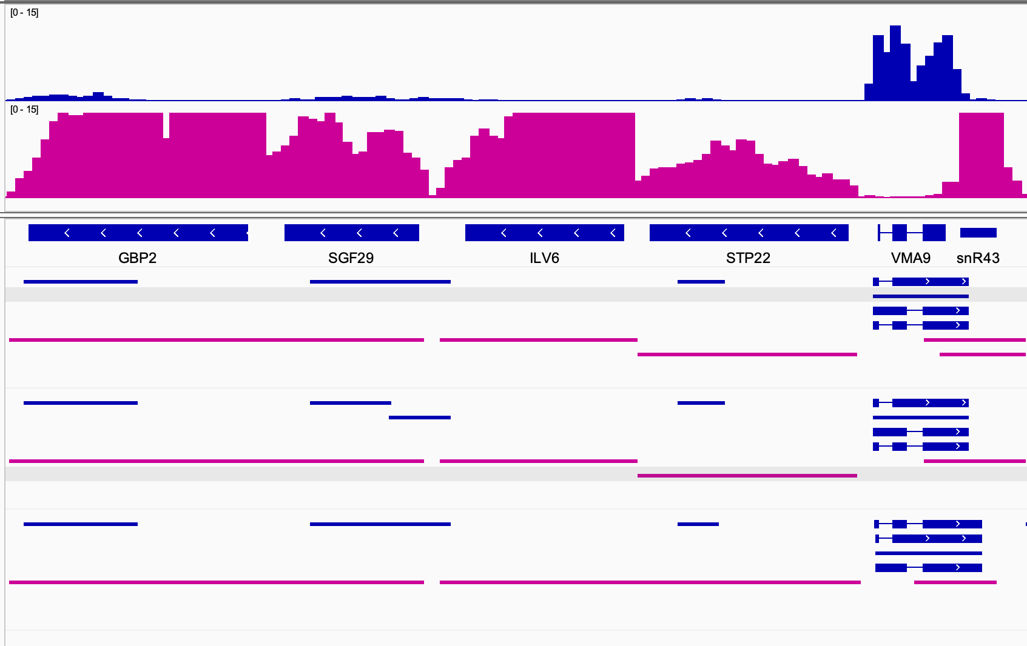
Defining transcript boundaries is a key challenge
Forward-stand transcription Q
Reverse-stand transcription Q
Prepro: trim, rcor
PASA: gene_overlap 30
Multi-mappers: 10
Alignment: EndToEnd
One of the best via “mRNA test”
Prepro: trim, rcor
PASA: stringent 20
Multi-mappers: 10
Alignment: EndToEnd
One of the best PASA “stringent” via “mRNA test”
Prepro: None
PASA: minimal_overlap
Multi-mappers: 10
Alignment: Local
One of the worst via “mRNA test”
mRNA test
Ratio of (a) number of transcripts covering entirety of official CDS to (b) number of transcripts where CDS is 70% of total transcript
No mode splits these into separate transcripts
minimal_overlap lumps these together inappropriately
Slide and work by Alison; edited by Kris

Slide 29
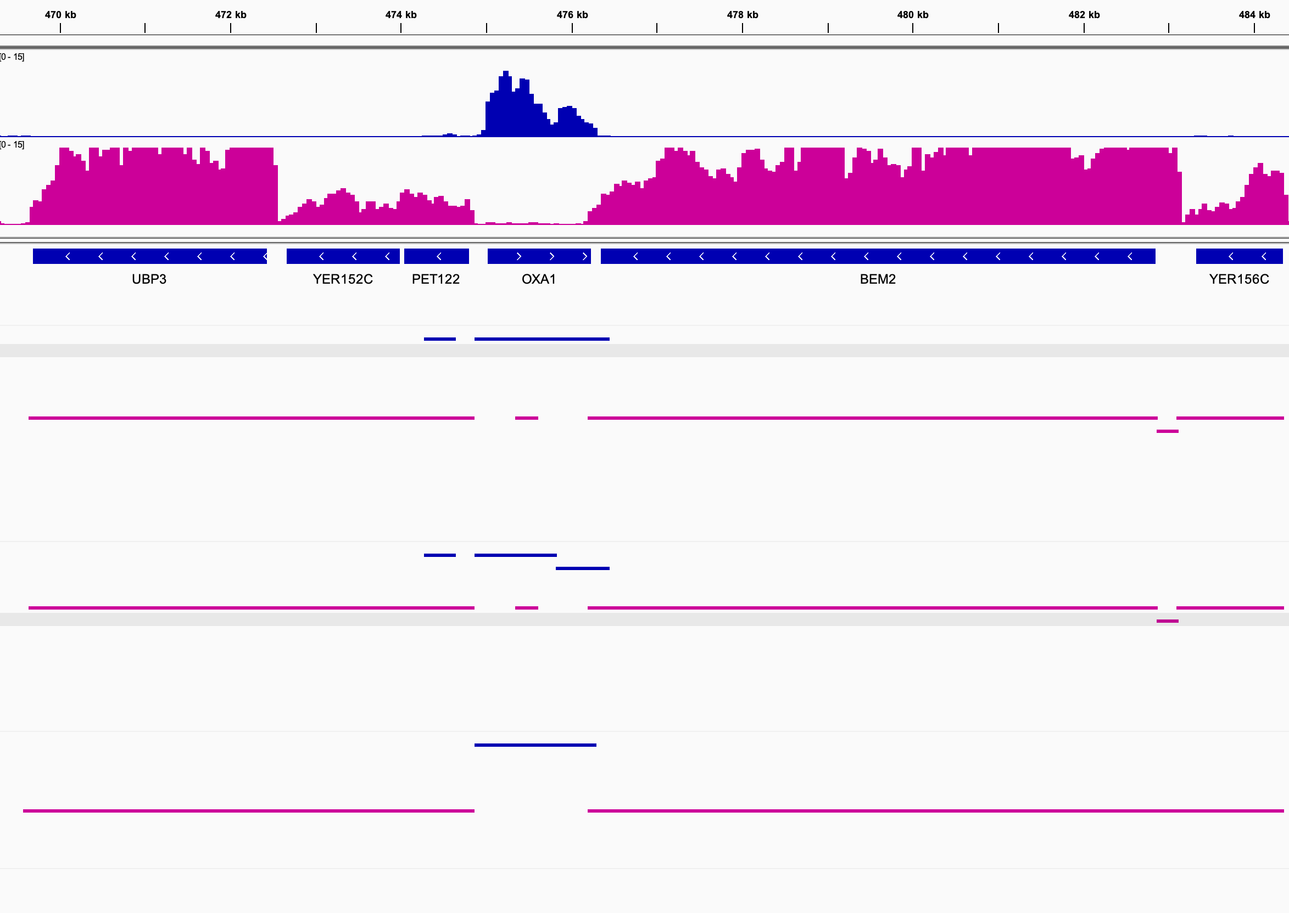
Defining transcript boundaries is a key challenge cont.
Forward-stand transcription Q
Reverse-stand transcription Q
Prepro: trim, rcor
PASA: gene_overlap 30
Multi-mappers: 10
Alignment: EndToEnd
One of the best via “mRNA test”
Prepro: trim, rcor
PASA: stringent 20
Multi-mappers: 10
Alignment: EndToEnd
One of the best PASA “stringent” via “mRNA test”
Prepro: None
PASA: minimal_overlap
Multi-mappers: 10
Alignment: Local
One of the worst via “mRNA test”
mRNA test
Ratio of (a) number of transcripts covering entirety of official CDS to (b) number of transcripts where CDS is 70% of total transcript
PASA “stringent” splits these inappropriately
Slide and work by Alison; edited by Kris

Slide 30
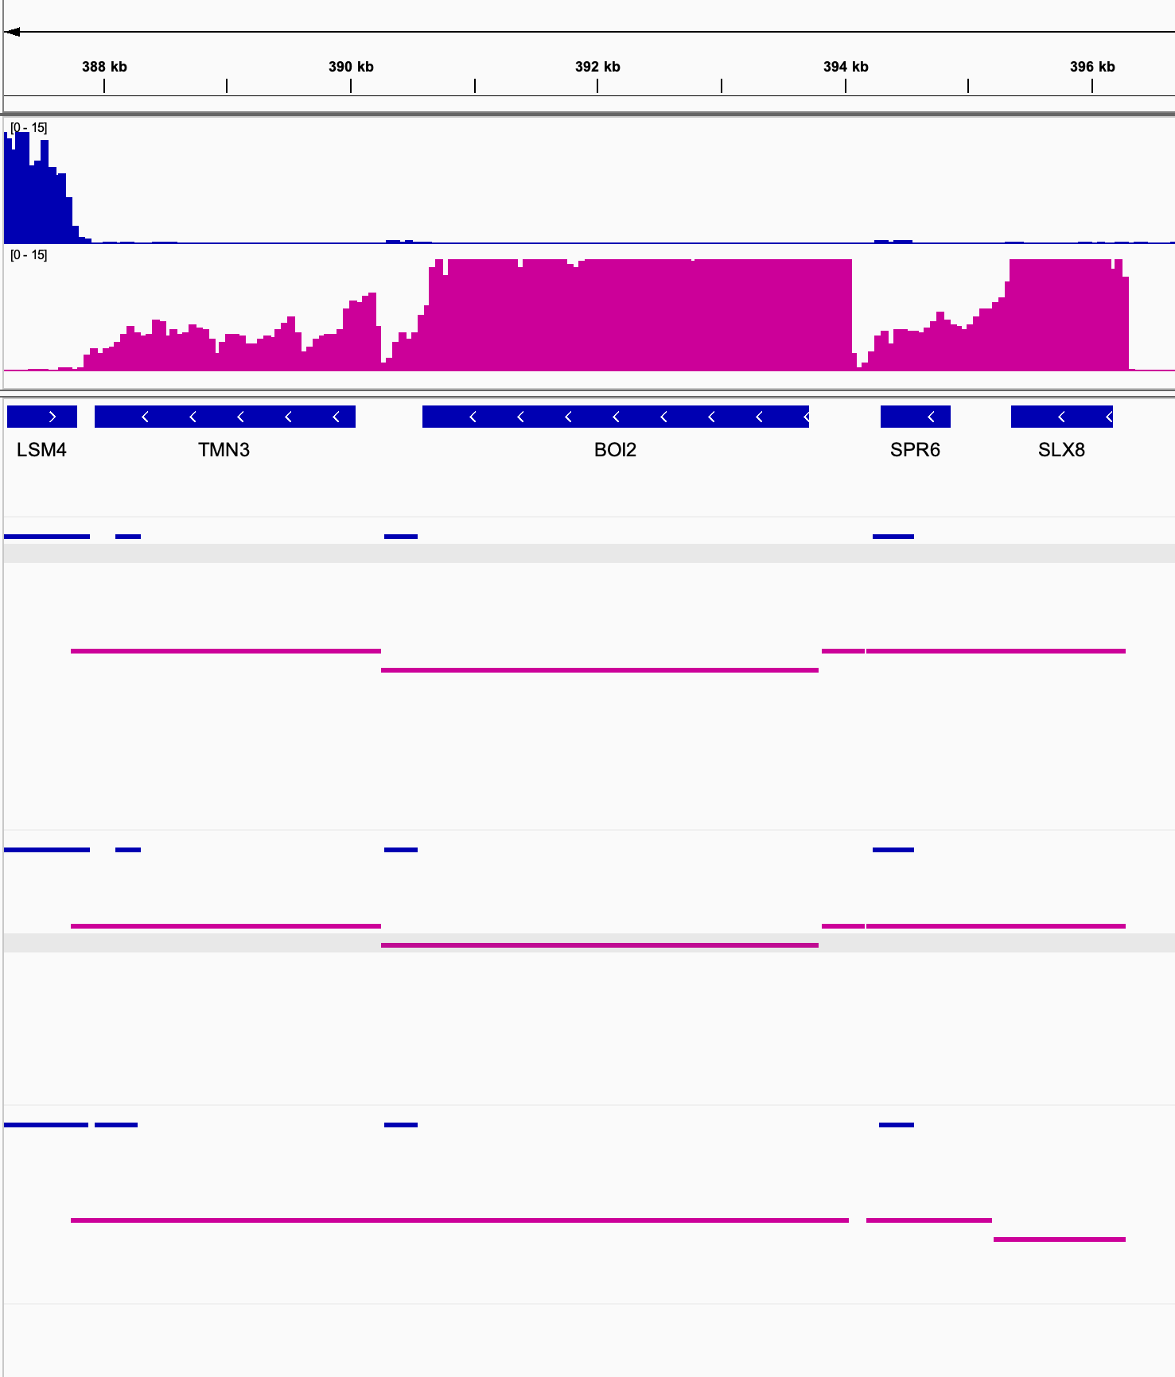
No mode is always best ☹
Forward-stand transcription Q
Reverse-stand transcription Q
Prepro: trim, rcor
PASA: gene_overlap 30
Multi-mappers: 10
Alignment: EndToEnd
One of the best via “mRNA test”
Prepro: trim, rcor
PASA: stringent 20
Multi-mappers: 10
Alignment: EndToEnd
One of the best PASA “stringent” via “mRNA test”
Prepro: None
PASA: minimal_overlap
Multi-mappers: 10
Alignment: Local
One of the worst via “mRNA test”
mRNA test
Ratio of (a) number of transcripts covering entirety of official CDS to (b) number of transcripts where CDS is 70% of total transcript
minimal_overlap is bad here
minimal_overlap is better here
Slide and work by Alison; edited by Kris

Slide 31
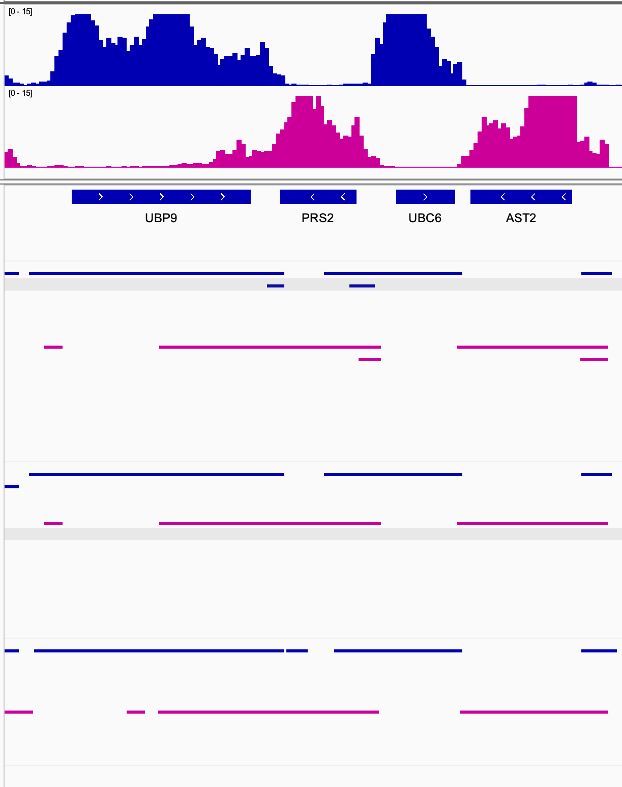
Gene overlap mode generates small additional fragments – unclear if these are “real” or not
Forward-stand transcription Q
Reverse-stand transcription Q
Prepro: trim, rcor
PASA: gene_overlap 30
Multi-mappers: 10
Alignment: EndToEnd
These seem like they would be easy to remove…
One of the best via “mRNA test”
Prepro: trim, rcor
PASA: stringent 20
Multi-mappers: 10
Alignment: EndToEnd
One of the best PASA “stringent” via “mRNA test”
Prepro: None
PASA: minimal_overlap
Multi-mappers: 10
Alignment: Local
One of the worst via “mRNA test”
mRNA test
Ratio of (a) number of transcripts covering entirety of official CDS to (b) number of transcripts where CDS is 70% of total transcript
Slide and work by Alison; edited by Kris

Slide 32
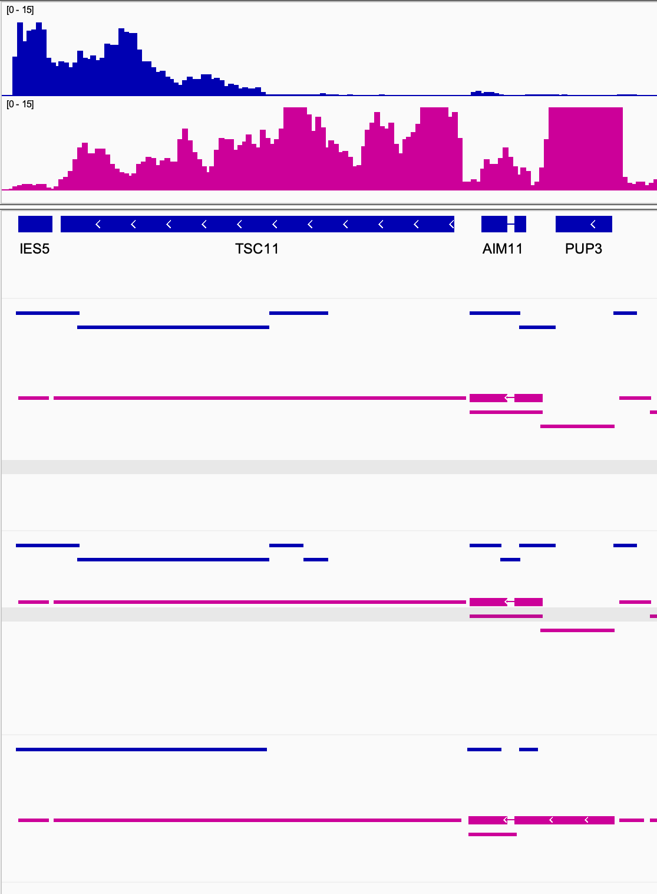
Minimal Overlap can be better at capturing lowly expressed transcripts but this has drawbacks
Forward-stand transcription Q
Reverse-stand transcription Q
Prepro: trim, rcor
PASA: gene_overlap 30
Multi-mappers: 10
Alignment: EndToEnd
One of the best via “mRNA test”
Prepro: trim, rcor
PASA: stringent 20
Multi-mappers: 10
Alignment: EndToEnd
One of the best PASA “stringent” via “mRNA test”
Prepro: None
PASA: minimal_overlap
Multi-mappers: 10
Alignment: Local
One of the worst via “mRNA test”
mRNA test
Ratio of (a) number of transcripts covering entirety of official CDS to (b) number of transcripts where CDS is 70% of total transcript
minimal_overlap also
makes this one transcript :(
minimal_overlap makes this one transcript!
Slide and work by Alison; edited by Kris

Slide 33
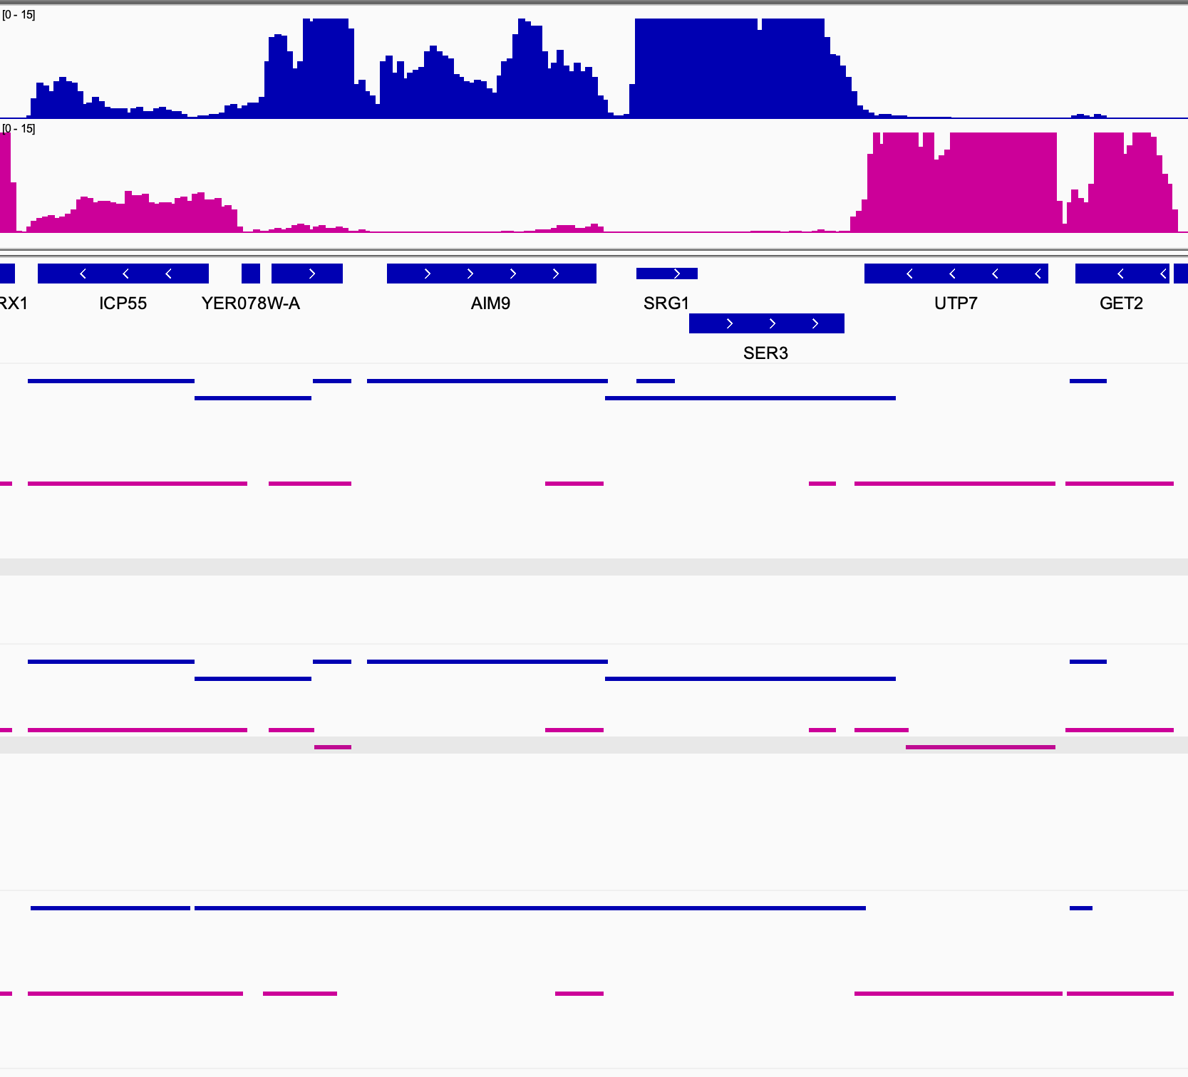
minimal_overlap may be better at capturing lowly expressed transcripts, but this has drawbacks
Forward-stand transcription Q
Reverse-stand transcription Q
Prepro: trim, rcor
PASA: gene_overlap 30
Multi-mappers: 10
Alignment: EndToEnd
One of the best via “mRNA test”
Prepro: trim, rcor
PASA: stringent 20
Multi-mappers: 10
Alignment: EndToEnd
One of the best PASA “stringent” via “mRNA test”
Prepro: None
PASA: minimal_overlap
Multi-mappers: 10
Alignment: Local
One of the worst
via “mRNA test”
mRNA test
Ratio of (a) number of transcripts covering entirety of official CDS to (b) number of transcripts where CDS is 70% of total transcript
Split into multiple transcripts, but unclear if boundaries are correct
Minimal overlap makes this one transcript inappropriately
Slide and work by Alison; edited by Kris

